Slide 1

CincyDeliver 2019 Sponsors

Slide 2
Building in Quality:
The Beauty of Behavior Driven Development (BDD)
Larry Apke
Chief Agile Officer – The Job Hackers
Agile Coach - Omnicell
Notes:
Tell the story about how I became associated with BDD because it is a good example of the efficacy of retrospectives. – BDD Questions – When do we do the BDD scenarios as acceptance criteria?

Slide 3
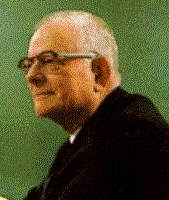
Deming on Quality
“Quality comes not from inspection, but from improvement of the production process.”
“We cannot rely on mass inspection to improve quality… You cannot inspect quality into a product.' The quality is there or it isn't by the time it's inspected.”
Notes:
Most of what we refer to as QA in software development is usually inspection after the fact. In the case of Waterfall, far after the fact. Behavior Driven Development (BDD) provides us with the ability to inject quality into our product instead of merely inspecting after the fact. It moves testing to the beginning of the process instead of the end, creating a higher quality product that can be built quickly.

Slide 4





BDD Begins with
Test Driven Development (TDD)
Red
Write a unit test
Validate that the test fails
Refactor the code
Coherence is ensured by the unit tests
TDD
Refactor
Green
Write just the minimum code necessary
Validate that the test passes successfully

Slide 5
Why Do TDD?
“Ilities” – Maintainability, Flexibility, Extensibility
Streamlined Codebase
Cleaner Interfaces
Easier Refactoring of Code
Tests Provide Some Code Documentation
Bottom Line - Higher Quality
Red
TDD
Refactor
Green
Notes:
Did not say High Percentage of Test Code Coverage because test code coverage number is merely directional – high coverage is probably better than low coverage

Slide 6

An Expert Speaks on TDD
“If the discipline of requirements specification has taught us anything, it is that well-specified requirements are as formal as code and can act as executable tests of that code!”
Notes:
BDD and TDD provide us with the executable tests of the code we write.

Slide 7
An Expert Speaks on TDD
“…if you want to go fast, if you want to get done quickly, if you want your code to be easy to write, make it easy to read.”
“Indeed, the ratio of time spent reading versus writing is well over 10 to 1. We are constantly reading old code as part of the effort to write new code. ...[Therefore,] making it easy to read makes it easier to write.”
Notes:
Being able to read code is more important than writing it. Being able to write readable code is critical to success and speed.

Slide 8
An Expert Speaks on Being a Professional Developer
“Perhaps you thought that “getting it working” was the first order of business for a professional developer…but the readability of your code will have a profound effect on all the changes that will ever be made.”
“Programmers who satisfy themselves with merely working code are behaving unprofessionally.”

Slide 9

So, Why Doesn’t Everyone Do TDD?
Most developers have not learned TDD and there is a learning curve
TDD is extremely disciplined
There is a perception that development is slower
It is difficult to introduce with legacy code
Developers often need to mock objects and learn mocking
“I kept coming across the same confusion and misunderstandings. Programmers wanted to know where to start, what to test and what not to test, how much to test in one go, what to call their tests, and how to understand why a test fails.” - Dan North - Introduction to BDD

Slide 10

Why Do BDD?
TDD builds it right, BDD builds the right thing.
While there is no silver bullet to software development, BDD (when coupled with continuous integration) comes as close as anything I have found.
My blog - “10 Reasons Why BDD Changes Everything” was published on 3/6/2012 and still is the most visited page on my website.

Slide 11
Ten Reasons Why BDD Changes Everything
Communication between business and development is extremely focused as a result of common language.
Business needs tie directly to the code that is written.
Developers know what test cases they should write to accommodate TDD.
All the underlying benefits of TDD become more easily realized.
Code is easier to maintain.
Code is self documenting.
Stories are easier to refine – breakdown, task and plan.
Teams can be more agile.
Developers can be trained / on-boarded easier.
There is more visibility into team progress and status.

Slide 12
How BDD Fits With TDD
Red
Write a unit test
Validate that the test fails
Refactor the code
Coherence is ensured by the unit tests
BDD
TDD
Refactor
Green
Write just the minimum code necessary
Validate that the test passes successfully

Slide 13

BDD – Real World Stories
Expressing Acceptance Criteria as BDD scenarios breaks the bottle neck in story writing for a small financial services company in Scottsdale, Arizona.

Slide 14

BDD – Real World Stories
BDD provides support necessary to successfully deliver MVP into production in record time for financial services company in San Antonio, Texas.
Notes:
From POC to customers hands in less than 90 days.
When it was over, they went on “barnstorming” sessions to teach BDD throughout the organization, touting their success. One quote I remember from their training was that there were times they were inclined to write code first without using BDD and TDD because they thought it would be faster. It was this code that had the most problems and took longer to bring to the quality they wanted.

Slide 15

Adopting BDD – Three Simple Steps
Step One
Write our story acceptance criteria using BDD scenarios
Step Two
Leverage these BDD scenarios to write our automated tests first in true TDD fashion
Step Three
Leverage a BDD Tool like Cucumber to map human-readable BDD scenarios to the automated tests

Slide 16

Step One – Write Acceptance Criteria in BDD Style
Step One is accomplished by the three amigos - Product Owner, Developer(s) and Quality Assurance Person(s).
Step One is accomplished during Story Refinement which is where we go into detail for the stories that we believe we will take during the next iteration.
This is the first step in transitioning to BDD and the one that brings the most benefit. It was a pleasant surprise to Dan North and crew, something that they did not plan. Better communication equals better quality.

Slide 17
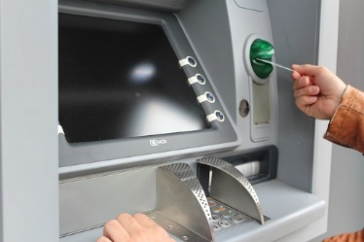
Step One – Write Acceptance Criteria in BDD Style
The Story
Customer Withdraws Cash
As a customer,
I want to withdraw cash from an ATM,
So that I don’t have to wait in line at the bank.

Slide 18
Step One – Write Acceptance Criteria in BDD Style
The Story
Customer Withdraws Cash
Scenario 1 - Account is In Credit
Given the account is in credit
And the card is valid
And the dispenser contains cash
When the customer requests cash
Then ensure the account is debited
And ensure cash is dispensed
And ensure the card is returned
Notes:
Notice that the scenario is basically a test case. It has prerequisite Given – where am I and what am I doing, it has a change to the system – When and then it has the systems reaction to the behavior change – Then.

Slide 19
Step One – Write Acceptance Criteria in BDD Style
The Story
Customer Withdraws Cash
Scenario 2 - Account is overdrawn past the overdraft limit
Given the account is overdrawn
And the card is valid
When the customer requests cash
Then ensure a rejection message is displayed
And ensure cash is not dispensed
And ensure the card is returned
Notes:
The Givens will be mostly the realm of QA because it takes a QA mindset. The Thens are the realm of the Product Owner – as a business how do you want the system to react when this change occurs.

Slide 20
Step Two – Use BDD Scenarios
to Write Tests
In step two we leverage BDD to write our tests and begin the process of TDD. BDD scenarios can be written directly into tests using comments.

Slide 21
Step Two – Use BDD Scenarios
to Write Tests
public class AccountIsInCreditTest extends TestCase {
@Setup
//Scenario 1 - Account is In Credit
// Given the account is in credit
// And the card is valid
// And the dispenser contains cash
//Write code here to mock out account and add credit, mock out card and set as valid, etc.
Notes:
This particular technique was suggested from the San Antonio financial services team I worked with.

Slide 22
Step Two – Use BDD Scenarios
to Write Tests
//When the customer requests cash
Call CustomerRequestsCash (Amount) //call method on class and pass values
@Test
//Then ensure the account is debited
// And ensure cash is dispensed
// And ensure the card is returned
Assert.AssertEquals(ExpectedAccountBalance, Account.Balance);
Assert.AssertEquals(CashDispensed, True);
Assert.AssertEquals(CardReturned, True);
}

Slide 23

Step Three – Use a BDD Tool
BDD Tool will take human-readable scenarios and use regular expressions to map the human readable scenarios to Unit Tests.
BDD Tools will create a unit test and shell automatically (referred to as a step definition file) that helps in the creation of test.
When the BDD Tool runs the tests, the output shows which tests passed and failed against the human-readable scenarios.
There are BDD Tools for all major languages. I recommend Cucumber for Java and Ruby.
Notes:
There is also SpecFlow for .Net, Lettuce for Python, Spock for Groovy, Jbehave for Java.

Slide 24
Step Three – Use a BDD Tool
Scenario: Valid Log On
Given user navigates to logon page
When they enter valid user name and password
Then login should be successful

Slide 25
Step Three – Use a BDD Tool
@Given("^user navigates to logonpage$")
pending # express the regexp above with the code you wish you had
end
@When("^they enter valid Username as \"([^\"]*)\" and Password as \"([^\"]*)\"$")
pending # express the regexp above with the code you wish you had
end
@Then("^login should be successful$")
pending # express the regexp above with the code you wish you had
end

Slide 26
Step Three – Use a BDD Tool
@Given("^user navigates to logonpage$")
public void goToLogonPage() {
driver = new FirefoxDriver();
driver.navigate().to(“logonpage.htm");
} end
@When("^they enter valid Username as \"([^\"]*)\" and Password as \"([^\"]*)\"$")
public void ValidUserNameAndPassword(String arg1, String arg2) {
driver.findElement(By.id("email")).sendKeys(arg1);
driver.findElement(By.id("pass")).sendKeys(arg2);
driver.findElement(By.id(“submit")).click();
}
end

Slide 27
Step Three – Use a BDD Tool
#encoding: utf-8
Feature: Logging On
Scenario: Valid Log On # /logom:8
Given user navigates to logon page # /step_defs/logon.rb:3
When they enter valid user name and password # /step_defs/logon.rb:7
Then login should be successful # /step_defs/logon.rb:14
1 scenario (1 passed)
3 steps (3 passed)
0m0.005s

Slide 28
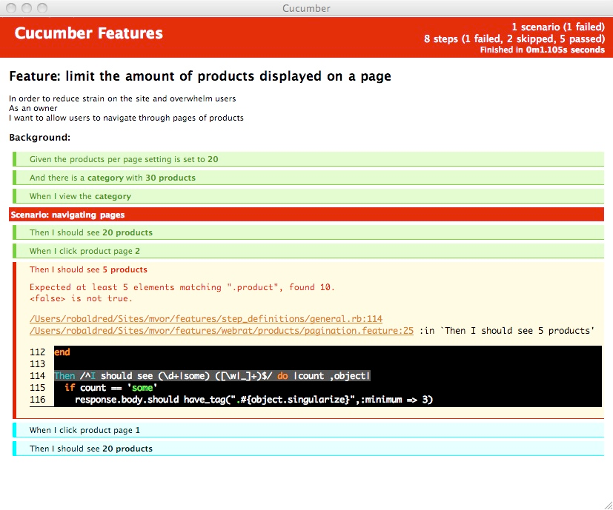
Step Three – Use a BDD Tool

Slide 29
Helpful Links
Dan North - Introduction to BDD
The Cucumber Book: Behaviour-Driven Development for Testers and Developers
BDD in Action: Behavior-driven development for the whole software lifecycle
Specification by Example: How Successful Teams Deliver the Right Software
Cucumber Tool
Serenity Tool
Clean Code: A Handbook of Software Craftsmanship

Slide 30
Questions

